Slide 1

Business Intelligence in Tamil
“Without data you are just another person with opinion”
- W. Edwards Deming.
Dinesh Kumar P
Product Manager – Reports & Analytics Squad
Kissflow Inc.

Slide 2

For what quality some people get a higher paid job?
1,00,000
70,000
50,000
25,000
Notes:
Let me ask a simple question. For what basic skill, different people get different salary? Perhaps that is the same basic thing which all the ML or AI projects are solving and make our life easier.

Slide 3



Decision Making
Notes:
Its DECISION MAKING. And that’s what AI is doing for Humans right? I can say many real time examples for this. For now, lets take - the Google Maps. Before 5 years, if you are riding to a destination for which you don’t know the route, you will constantly ask the persons who are on your path way, think over the route and go on. But now, Google Maps in our mobile phone, decides and tells this is the right route. And we are travelling just by looking into that Map path. Notice that here decision making work is partially taken over by the software comparing to the same situation before 5 years.
Software are no more just software. As engineers, we are making them as intelligent agents and make them evolve as more human in nature. Simply say, future machines with software will slowly rise to the conscious level of humans even!

Slide 4
Every progress in a work Driven by decision making
Programmer decides,
If branch (or)
Switch statement
Business man decides,
More discount (or)
Kind words
Data Analyst decides,
Linear model (or)
Regression model

Slide 5
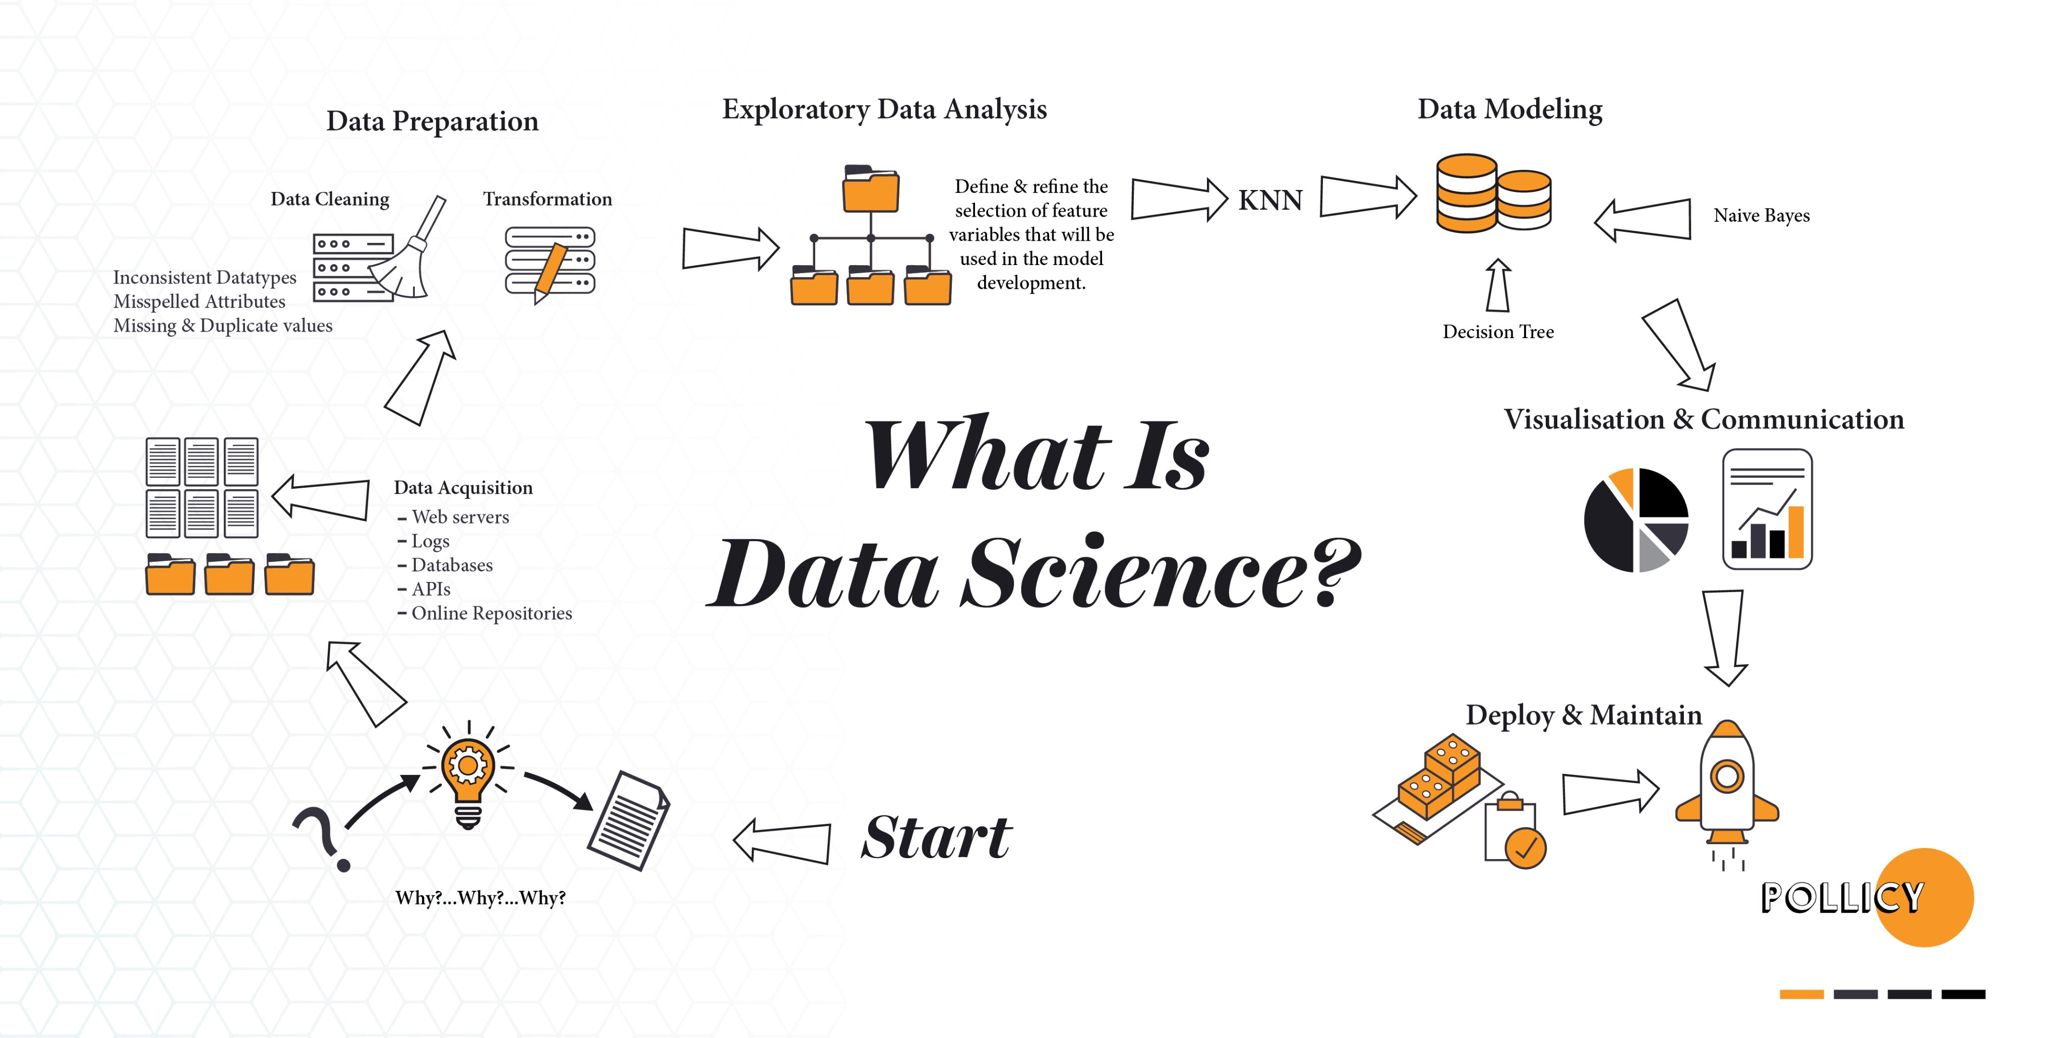

Slide 6
Review the customer feedbacks with 3 rating out of 5
Requirement
Build a cost-effective data pipeline system that analyzes customer feedbacks provided in a shopping website.
Prepare a Machine Learning model to know the sentiment of comments mentioned in feedbacks.
Also prepare a visualization that helps stake holders for decision-making.
Notes:
Details - An online shopping site store their feedback data in Azure SQL Data Warehouse. The data, in short, is about the rating(1 to 5) and comments by the buyer for each delivered order. The management would like to extract insights about this feedbacks and improve its business. Analysis of bad feedbacks with 1,2 rating and good feedbacks that are with 4,5 rating is straight forward. Feedbacks with 3-rating expresses the biased feeling of customers with both good and bad comments. So apart from the overall rating, the comments in 3-rating should be segregated as good and bad comments using Machine Learning. Finally need to prepare a business dashboard to showcase the feedbacks for the sake of decision making.

Slide 7
1. Defining Objective
Understand the domain & industry,
Discuss about the business need / problem,
Ask more and more WHYs?
Prepare the objectives.

Slide 8
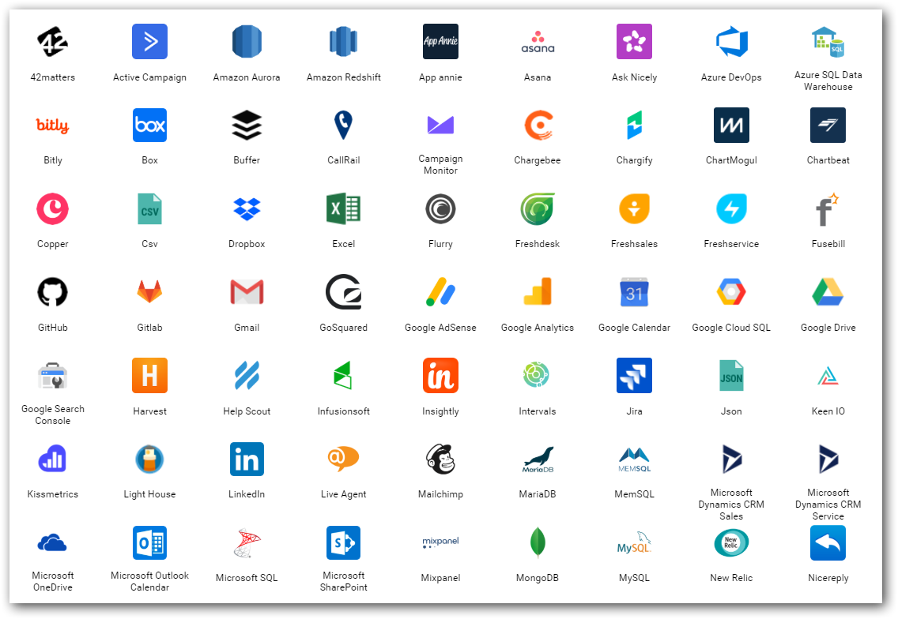
2. Data source(s)
Find out from where you need to get the data for your project.
Either provided or should search and find.
Logs
Databases
Web (REST APIs)
Social Media
…
Notes:
Logs – NASA logs which we gonna process.

Slide 9
3. Data Integration
Required data would exist in different sources those need to be brought to one place for,
Gather
Clean
Prepare
Tools
Apache Sqoop
Informatica
Apache Nifi…

Slide 10
4. Storage & Access
Different stages
Initial
Processing
Final
Instances & Services
Cloud Database instances (SQL Server, MySQL,..)
Amazon S3
Azure Blob / Azure Data Lake…
Access
API
Integration between processing tools

Slide 11
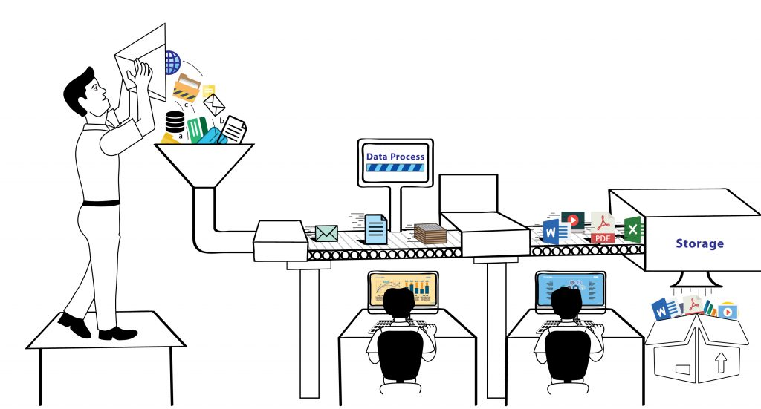
5. Process
Analyze / Do Analytics
ML models
Map Reduce
Tools & Services
Apache Pig / Hive / Spark
Amazon Sage Maker
Azure HDInsight / Databricks / ML Studio

Slide 12
6. Visualize
BI tools for business decisions
Microsoft Power BI
Tableau
Qlik
Bold BI
…
In-built packages in R, Python
Notes:
Most important.
This is how the top cream layer gets the view of their business that leads to decisions.

Slide 13


Importance of Business Intelligence and Visualization
How to convey your boss with data in Excel with thousands of rows?
Just convey it as a bar chart / pie chart.
Transform the data into charts, images,… that explain the numbers and allow us to get insights from it.
Meaning and purpose to the original data.
See the story that lives in your data.
Discover patterns (HISTORY), metrics (CURRENT) and spot trends (FUTURE).
Notes:
Usage will be lesser. But the importance will be more. Users will need the results found for important decision making.

Slide 14
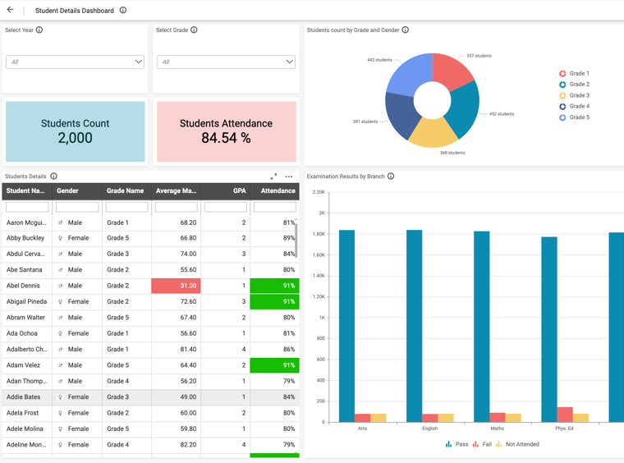
Sharing and Collaboration
User Management - Access control between users for Dashboard / Data source.
E.g. Currently we use.
Row level data security.
E.g. One Student Performance Analysis Dashboard for entire college;
Principal – Can see all departments.
Department head – Can see specific department alone.
Class Tutors – Can see specific class alone.
Notes:
Even Excel or R language can be used to create visuals.
Sharing and Collaboration is the one that makes BI differentiate itself from visualization.

Slide 15
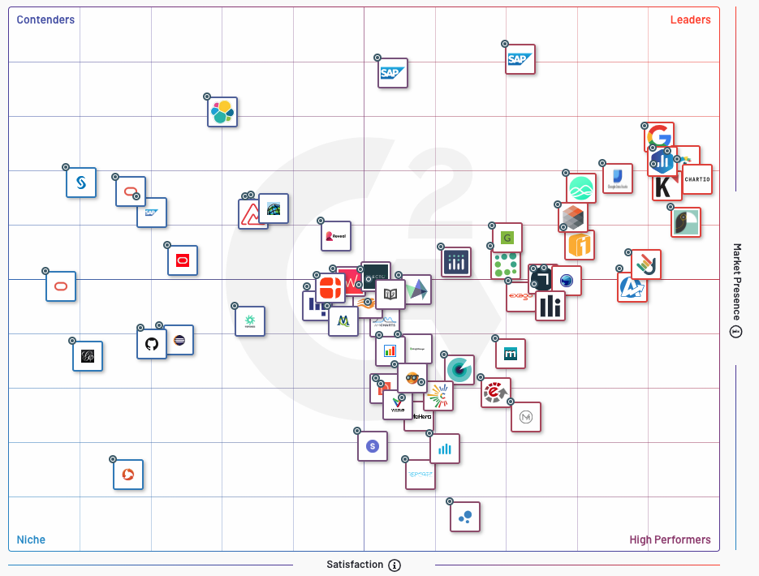

Slide 16
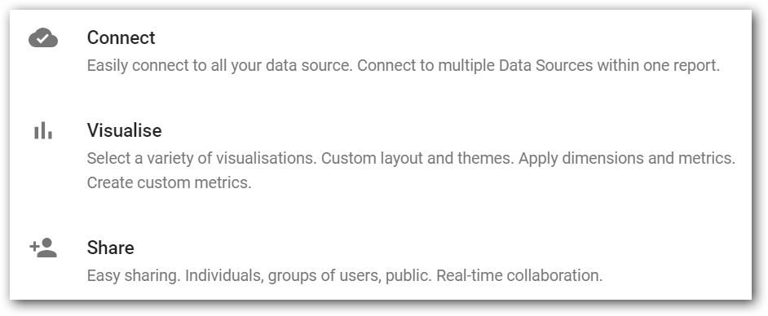

Slide 17

Things to know before creating a dashboard

Slide 18
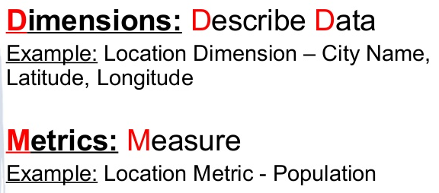
Dimensions vs Measures

Slide 19

Three things for effective visualization
Always audience in mind.
Clever in COLORS.
Use more Words.
June 2019
June 2020
Copyright © 2020 Syncfusion, Inc. All rights reserved.
Notes:
As mentioned in the first slide, effectively communicating the extracted insight to the target audience is important. These are 3 simple skills to improve the storytelling with data.
First and foremost is being specific about who your audience is. One should design everything keeping that audience in mind. Creating a chart for a communication purpose for our understanding is an easy task. If we step out of ourselves and think how do, we design for our audience will give effective results. Thinking is nothing but knowing ‘who are they’, ‘what do they care or expect’, ‘what keeps them up at night’.. Designing dashboards, keeping such motivation factors in mind will allow us to get their attention and can get our message across easily.
Next, coming to colors – It is not only about using pleasing colors in a dashboard. Think about where your audience to look and create a sparing contrast to achieve the attention.
Next, we should use more words in a dashboard. I mean it is words not sentences. Like axis labels, value labels, titles in a dashboard. Really these words will give more meaning quickly to the numbers and charts present in a dashboard.
https://visme.co/blog/dos-and-donts-chart-making/
https://infogram.com/blog/color-theory-dos-and-donts-for-data-visualization/

Slide 20
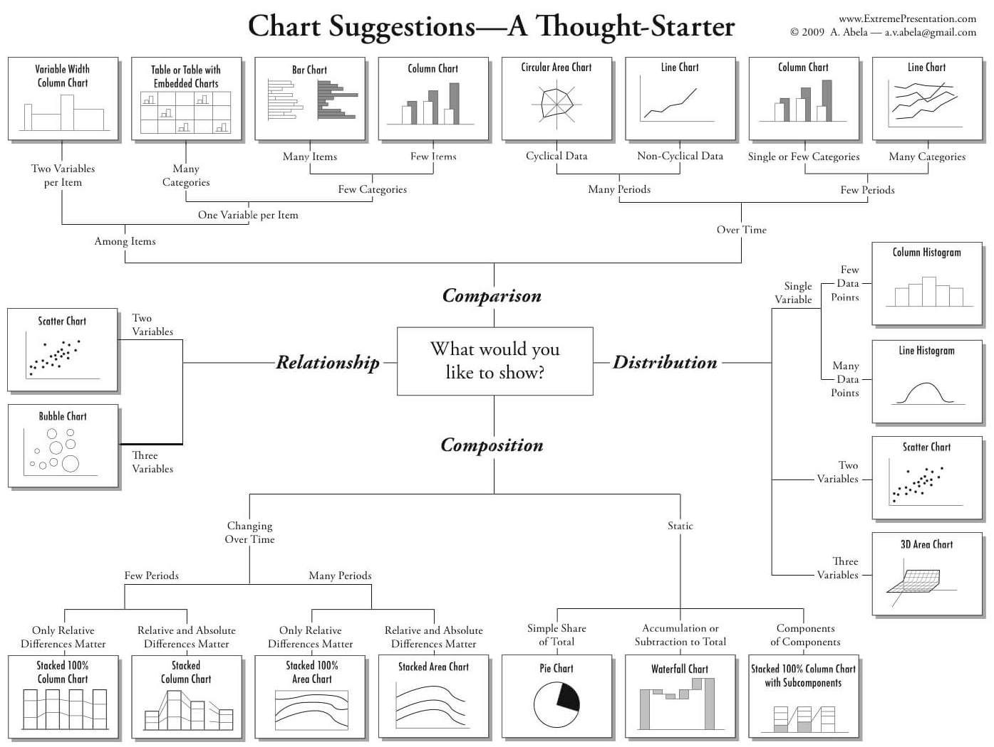
Notes:
This is like a rule book which most of us would be using while we get confused between choosing chart type.

Slide 21
Can you Answer?
Which one of the following is a Measure?
Sales Revenue
Sales Region
Sales Date
Notes:
Measures are numerical values that mathematical functions work on. Which one of the following is a Measure?

Slide 22
Can you Answer?
Which one of the following is a Dimension?
Net Profit
Purchase Price
Sales Person Name
Notes:
Which chart helps to find the relationship between data points?

Slide 23
Demo Zoho Reports Amazon QuickInsight Bold BI
Notes:
- There are so many tools and each Tool may vary based on their functionality (ETL first, visualization first, business users first, Search first,..). But what is important is Learn the basics.
- It is not that your learning completed when you come out of college. Learning just starts.

Slide 24
Let's see a video now...

Slide 25

Thank you! Questions ??

